Slide 1

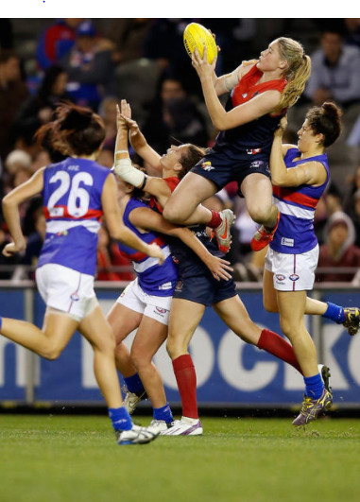
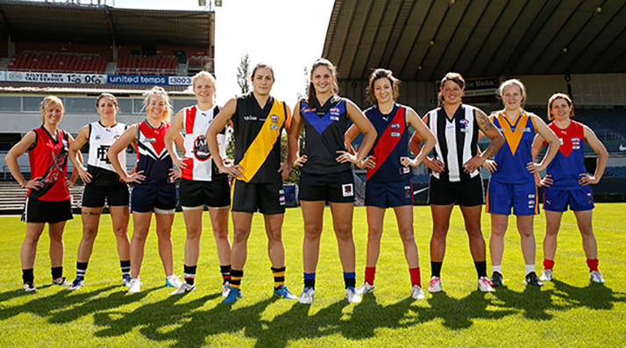
Women’s AFL
<- that’s our team name :DDD
ヾ(＾∇＾)
Business Analytics Lab Exercise
Wowowowowowow go women!!!
FOOTY FTW

Slide 2
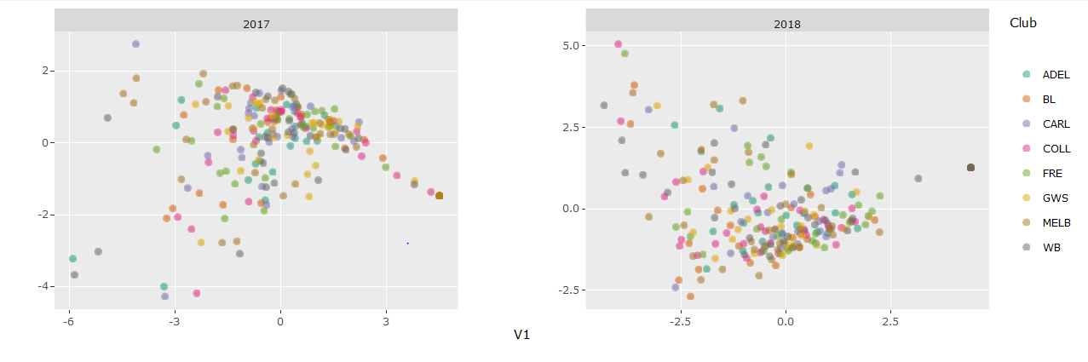
A plot of the data…
In terms of all players and all variables

Slide 3
An interesting thing we learnt… (≧▽≦)
The one who have similar values with the MVP of the AFLW may not get any award in the game.
Additionally, we found it interesting that the two winning teams in both 2017 and 2018 had a similar distribution of all round players (similar in data distribution).

